Slide 1
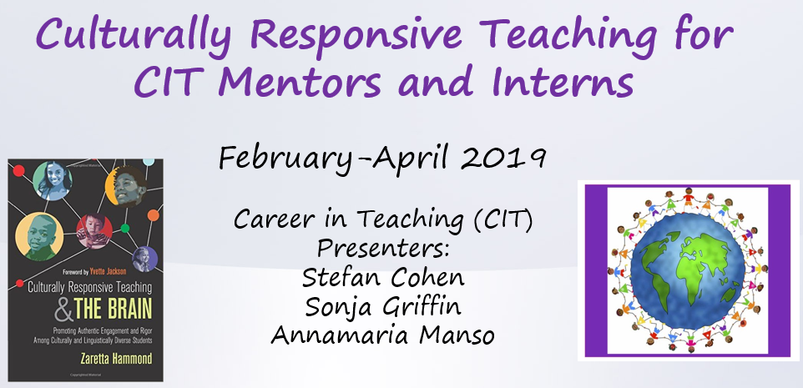
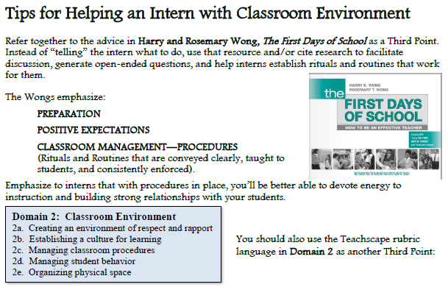
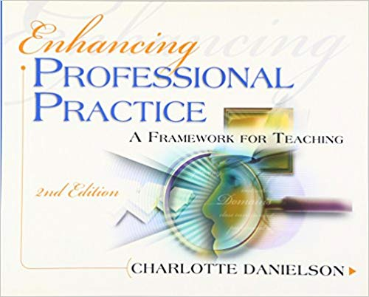
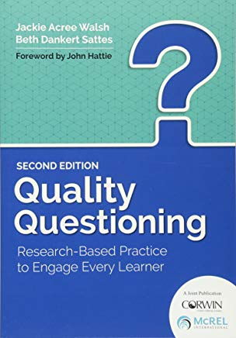
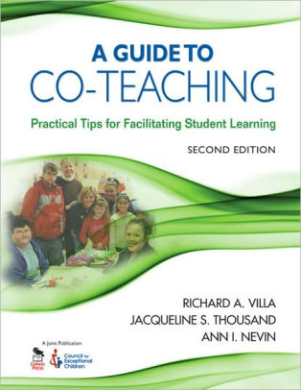
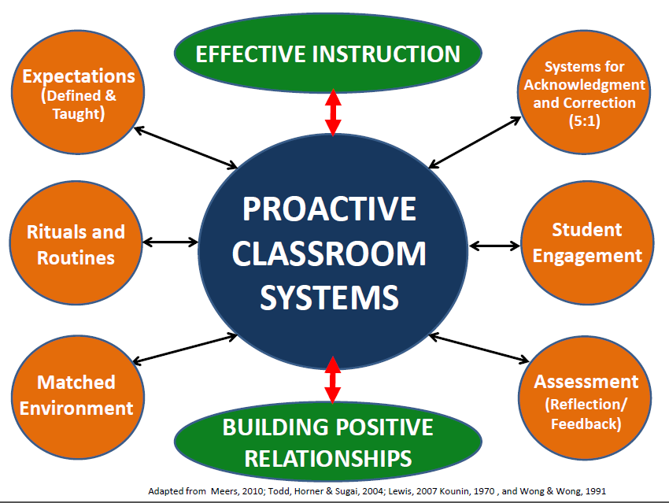
CIT Professional Learning

Slide 2
Career in Teaching Department Intern-Mentor Staff Development
Annamaria.Manso@RCSDK12.org

Slide 3
Professional Learning Opportunities
Career in Teaching Website
Left side – CIT Staff Development
CIT Professional Learning Catalog
Register at www.rcsdk12.truenorthlogic.com
ALL SESSIONS TO TAKE PLACE AT THE RTA OFFICES
30 North Union Street

Slide 4
Offerings
Classroom Management Q & A (10/9 – 4:15-6:15)
Co-Teaching; A Shared Belief System for Success in Teaching and Learning in the Special Education Classroom (Saturday, October 26th 9-2)
Learn How To Use The Danielson Framework To Enhance Your Practice
(12/2 and 12/9 – 4:15-6:15)

Slide 5
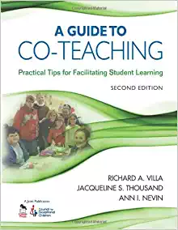
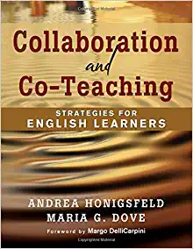
Co-Teaching; A Shared Belief System for Success in Teaching and Learning Saturday: October 26th, 9:00AM-2:00PM
We are encouraging team members to attend together…
Each team will receive one of the following books:

Slide 6
Bilingual
Best Practices for Working with ELLS: Incorporating Translanguaging Strategies into Instruction
Best Practices for Working with ELLS: Understanding the Bilingual Common Core Progressions
Best Practices for Working with ELLS: Using SIOP to Guide Planning and Instructio

Slide 7
Culturally Responsive Teaching and The Brain
Trauma and Resilience: What is a Trauma Informed School ?
Using Restorative Language in the Classroom
Integrating Peace Circles in the Classroom
Integrating Academic Circles in the Classroom
Self-Care for Teachers

Slide 8
Establishing Collaborative Classrooms Elementary (K-6)
Activities to implement and develop collaborative relationships within the classroom environment.
Using interactive modeling to reflect, develop and implement rituals and routines.
Reflect on teacher and student roles in developing collaborative classrooms through restorative practices, engagement, academic and behavioral protocols.

Slide 9
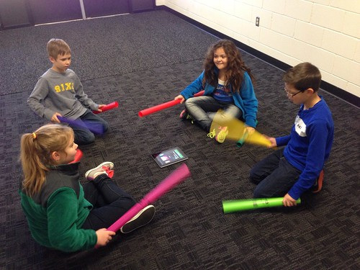




Secondary (7-12)
3 As
Creating a Positive Environment for Students
Creating an Environment of Respect and Rapport
Establishing a Culture for Learning

Slide 10
PROACTIVE CLASSROOM SYSTEMS
Building Positive Relationships
Defining and Teaching Expectations
Creating Systems for Acknowledgment and Correction
(5:1)
Establishing Rituals and Routines
Engaging Students
Matching the Environment
Utilizing for Assessment
Effective Instruction
Notes:
Here is the overview of the Proactive Classroom Systems course.

Slide 11
Social Workers, Psychologists, Speech Language Therapists, Counselors
Building positive relationships in an individual or small group setting
Trauma Informed Practices

Slide 12
Other Professional Learning Opportunities
Rochester Teaching Academy
Rochester Teacher Center
Roc Restorative

Slide 13
In Closing…
We are here to meet your needs! If there is something that you would like to see offered, talk to your mentor, or email me directly!
Annamaria.Manso@RCSDK12.org

